Slide 1

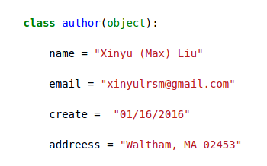
Medicare fraud detection by using open source data

Slide 2
Outline
Fraud detection is important in healthcare.
The data source
Feature engineering
Models
Results

Slide 3
Not many people but a lot of money got involved
Year | People Charged | False Billings, in Million
2010 | 94 | $251
2011 | 91 | $295
2012 | 2 | $1.9
2013 | 89 | $223
2014
2015 | 243 | $712
Data source: en.Wikipedia.org/wiki/Medicare_fraud

Slide 4
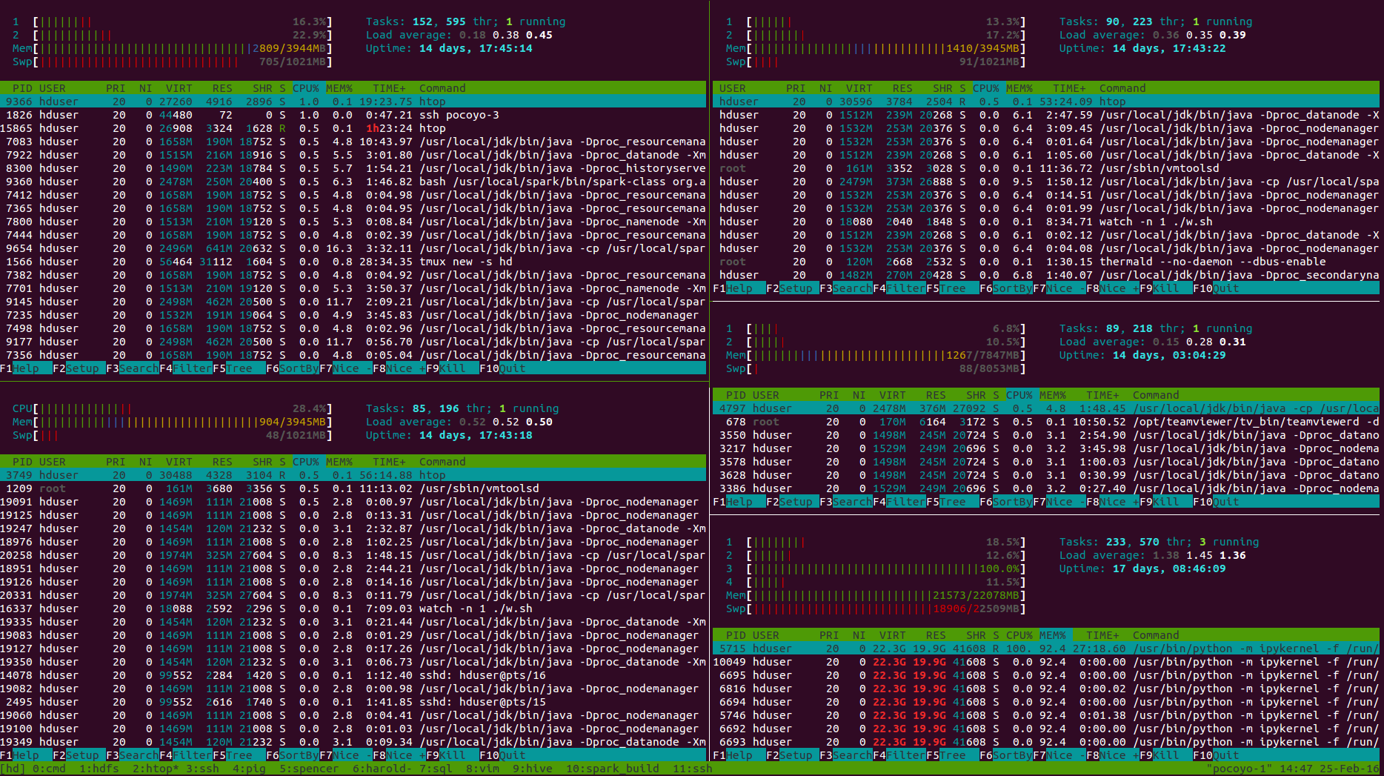
The cluster ( 5 nodes Hadoop/yarn/spark)
Node-1
2 core
4 G mem
Node-2
2 core
4 G mem
Node-4
2 core
8 G mem
Node-3
1 core
4 G mem
Node-5
4 core
22 G mem

Slide 5
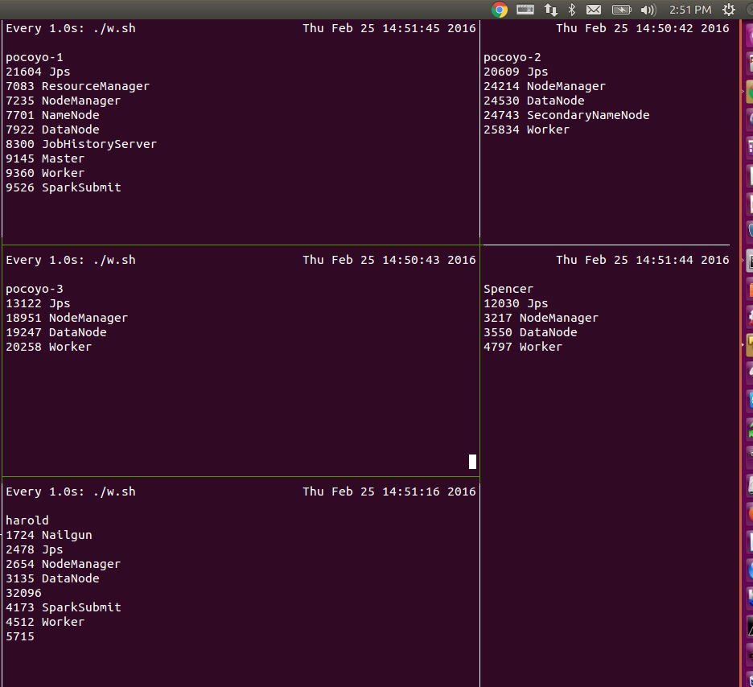
Another way to monitor the cluster

Slide 6
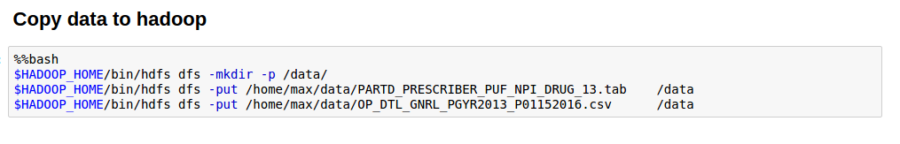
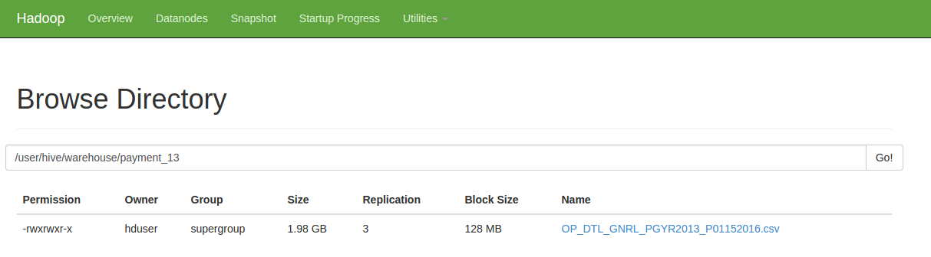
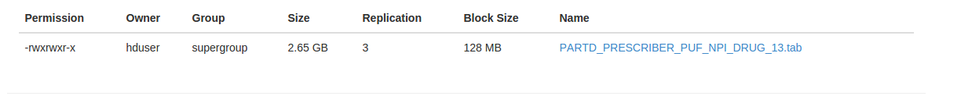
Copy files to Hadoop then move to Hive warehouse

Slide 7
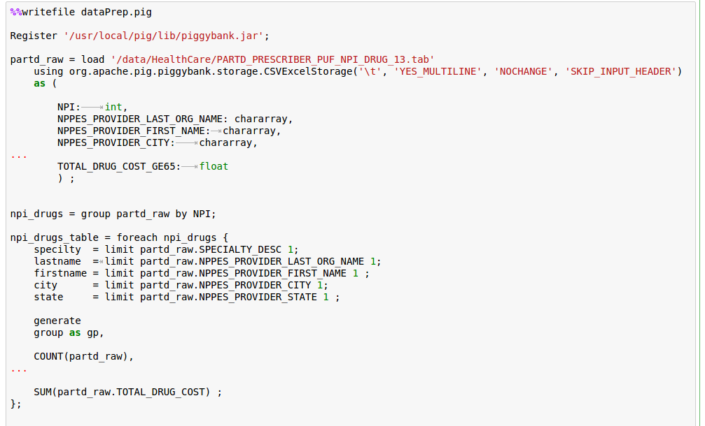
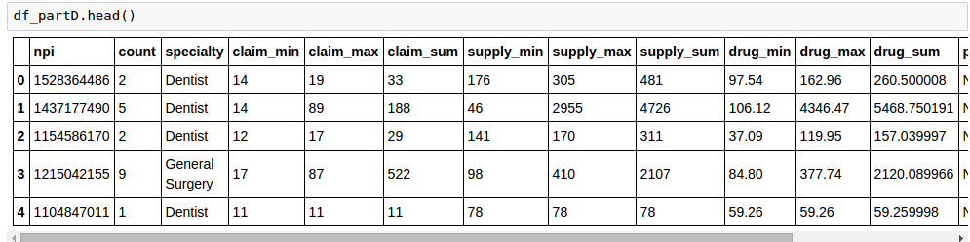
Pig scripts for data cleaning and table join

Slide 8
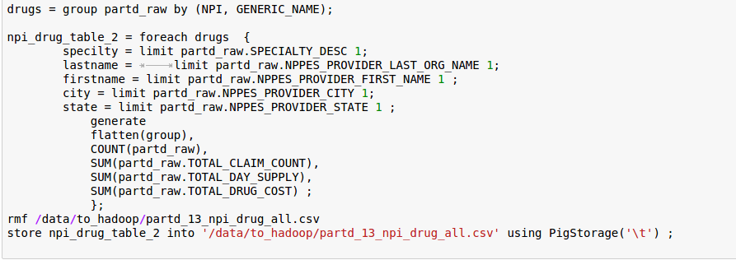
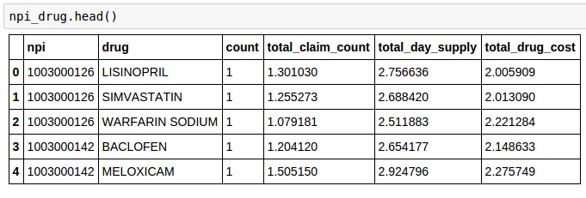

Slide 9
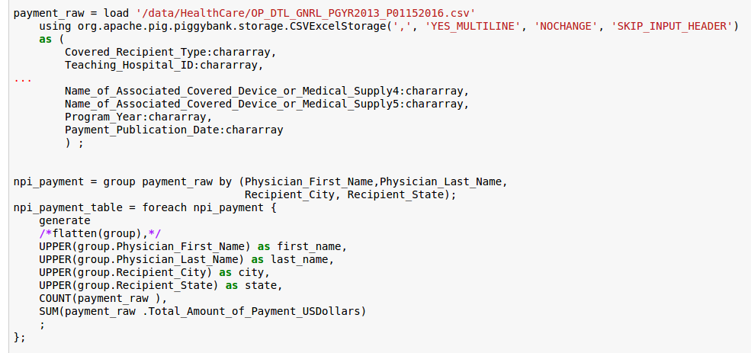
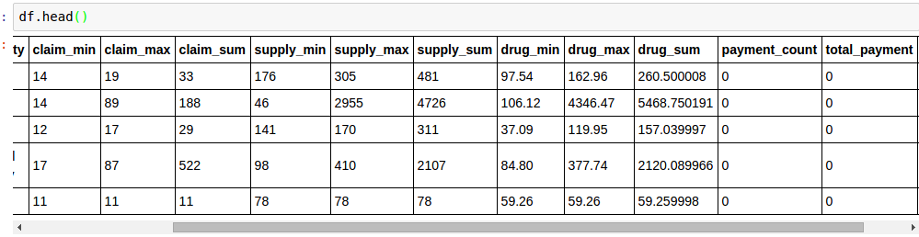

Slide 10
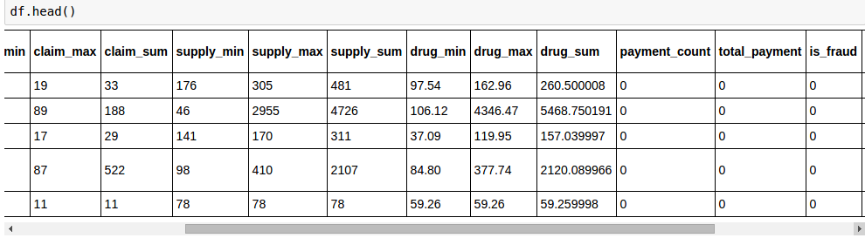
Npi exclusions database

Slide 11
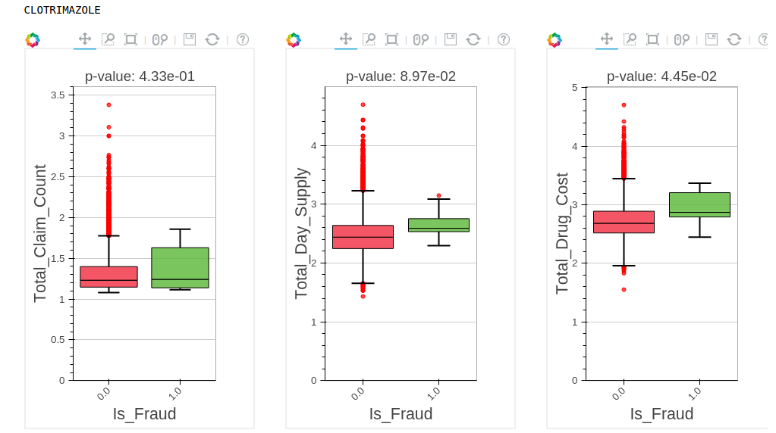
An example Select the feature with P<=0.05
NO
NO
YES

Slide 12
# Plots for the data, histogram or bar chart

Slide 13
Fitting results

Slide 14
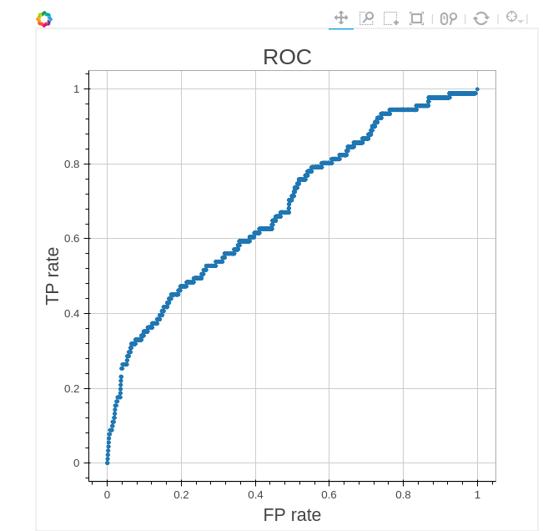
AUC from RandomForest
AUC = 0.685

Slide 15
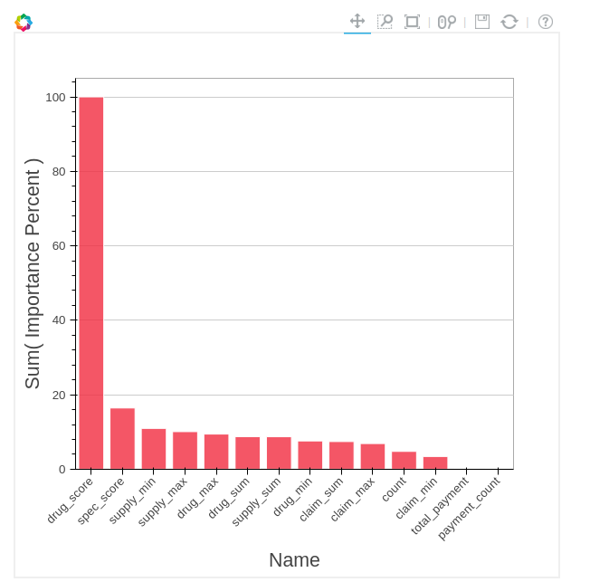

Slide 16
Ways to improve
Use more data, for example the Part-B dataset.
Add Page rank as a feature.
Model blend might help.

Slide 17
References
PageRank for Anomaly Detection by Ofer Mendelevitch and Jiwon Seo https://www.versustexas.com/criminal/healthcare-medicare-medicaid-fraud/

